Slide 1
Bobbin Brook
Easement Project

Slide 2
Moonseed Ct
Ditch would be cleaned out by the county for $510.00. They will move the rip rap downstream and/or set it aside so it can be moved down stream.
The county says the amount of sediment in the pipe is actually not out of specs.
The county said the rip rap was causing the sediment to pile up. Removing the rip rap and cleaning out the ditch will allow the pipe to clean out in one or two rain storms.
Ditch will have Geotech material to prevent erosion.

Slide 3
Moonseed Ct
From Bobbin Brook Circle to the drain (at the bottom of the picture) will have a asphalt swale, to prevent erosion and direct runoff to the drainage easement.
The sausage roll at the bottom will be opened up so the runoff gets into the drainage system.
Cost for the asphalt and the Geotech fabric is approximately $2400.00
Moonseed Ct. costs total $2910.00

Slide 4
Bobbin Brook Cir
Ditch will be cleaned out from driveway to driveway.
Geotech fabric will be placed in the ditch to prevent erosion.

Slide 5
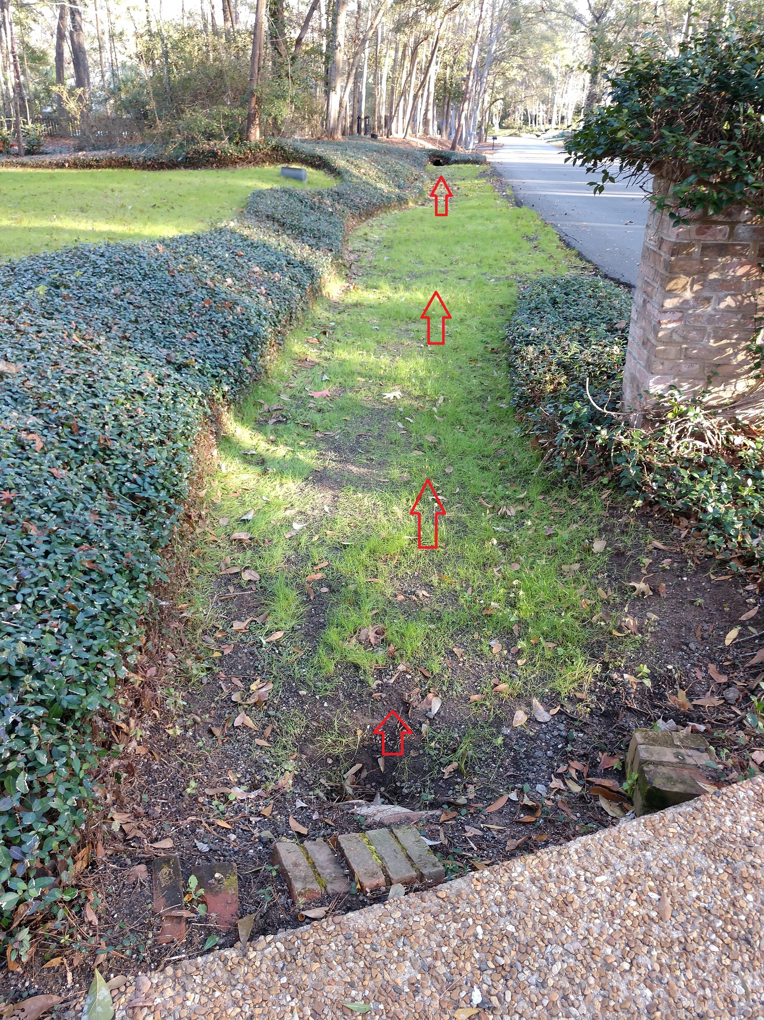

Slide 6
Bobbin Brook Cir
This ditch will be cleaned out and Geotech material placed to prevent erosion.
The water coming off of Bellflower will now be able to run down the swale on the property just north of this ditch. The runoff will then head north instead of west. This should relieve much of the water that may end up in the front yard of 3993 and potentially the back yard of 4005.
The cost for this repair is $510 to do the ditch clean out and $1200 for the Geotech materials and placement. Total $1710
Note: This costs includes a sausage roll on Gentian Ct. to ensure more goes to the concrete flume that runs along 943 Gentian.

Slide 7
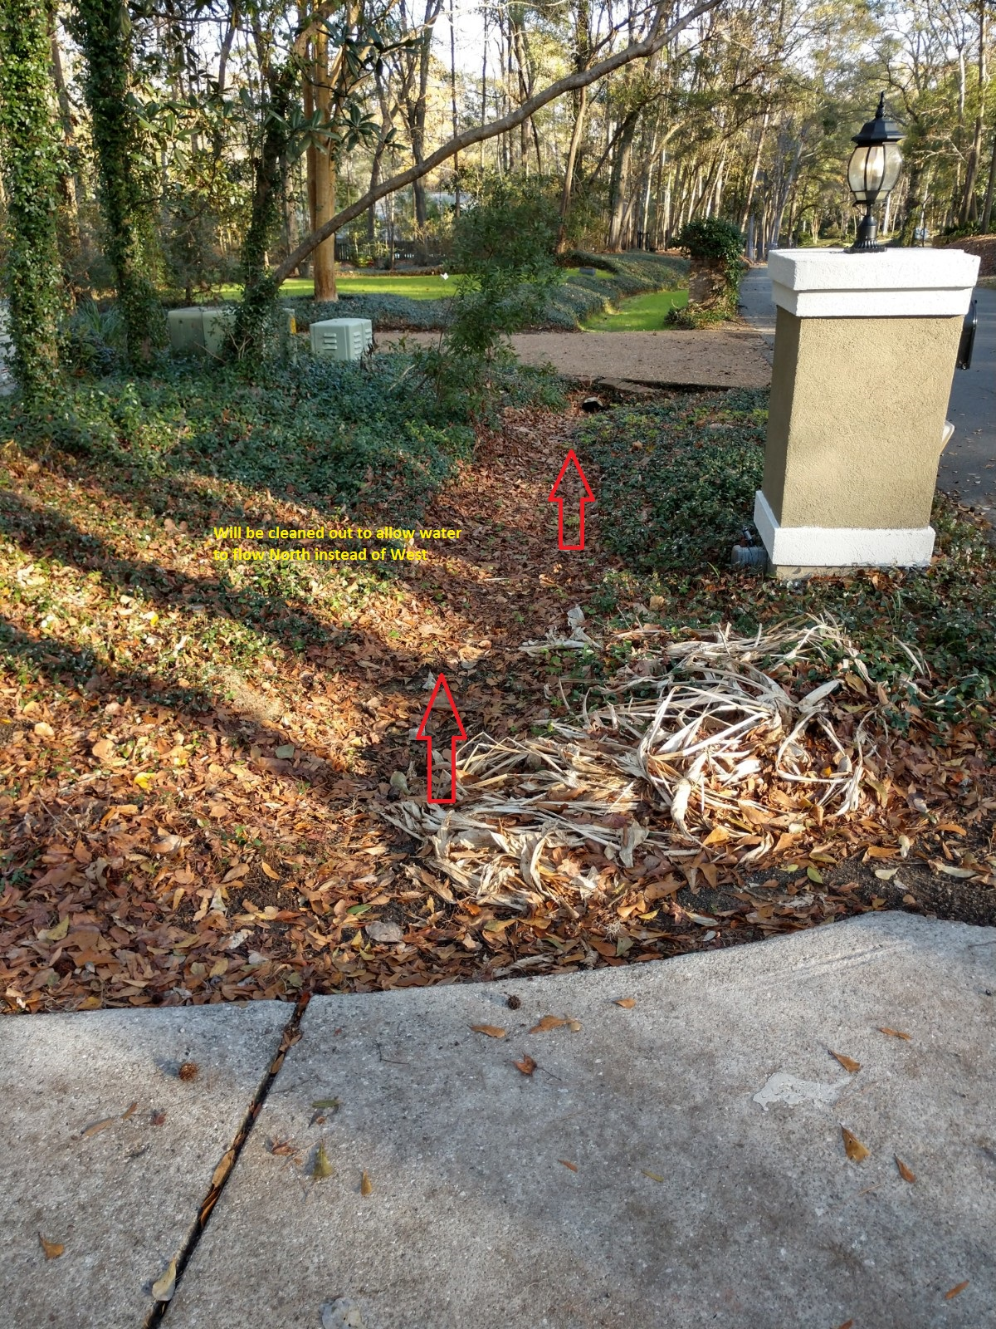

Slide 8
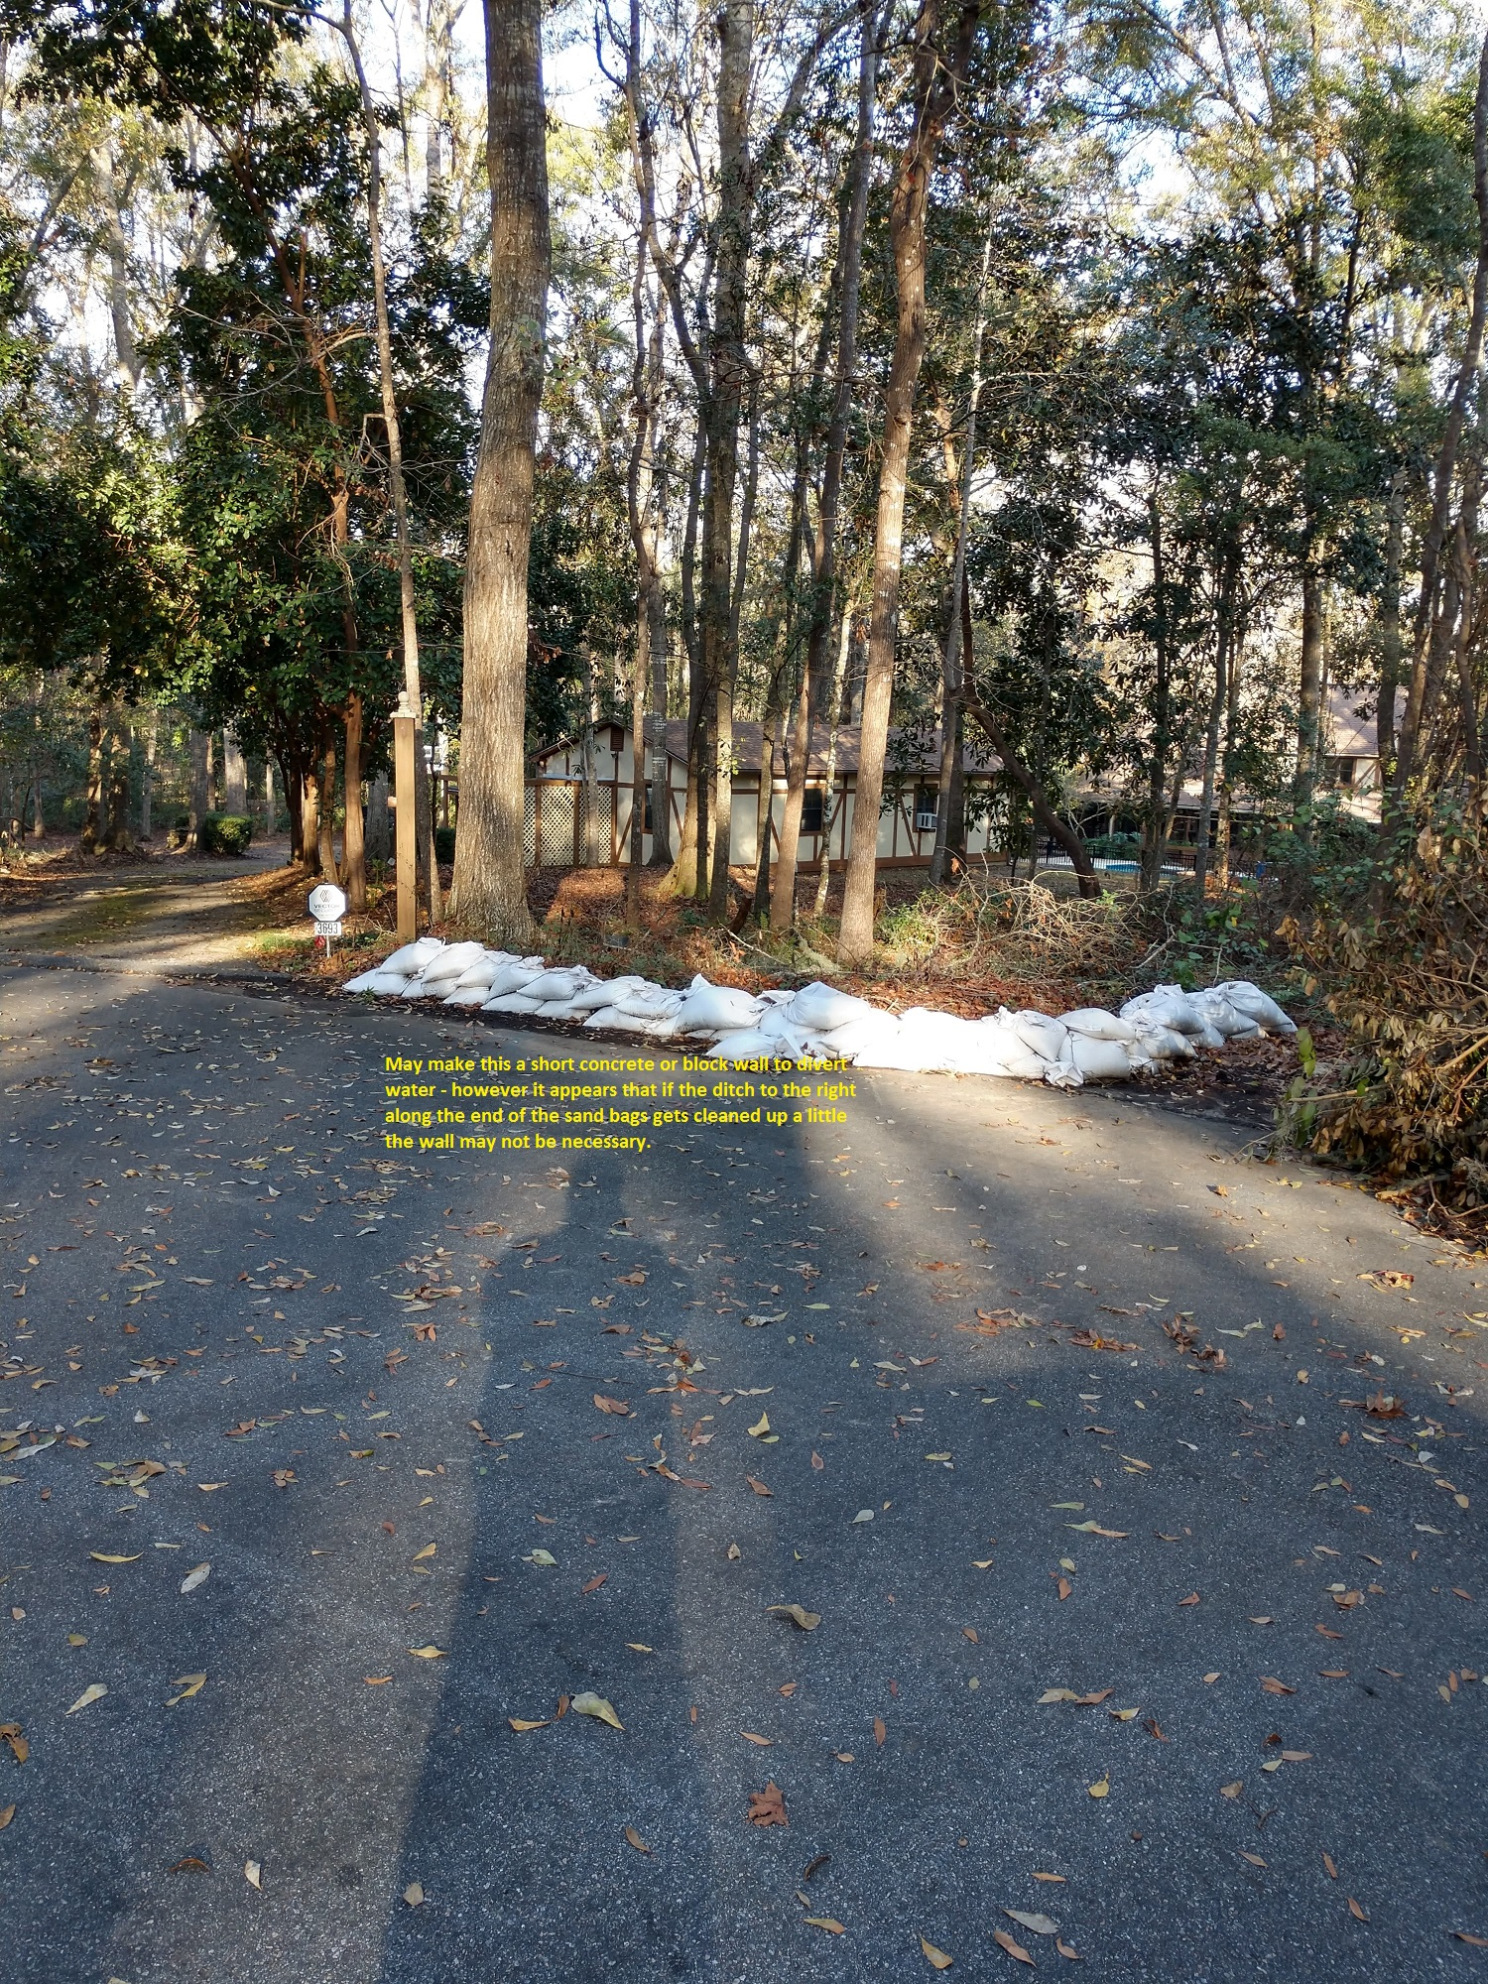

Slide 9
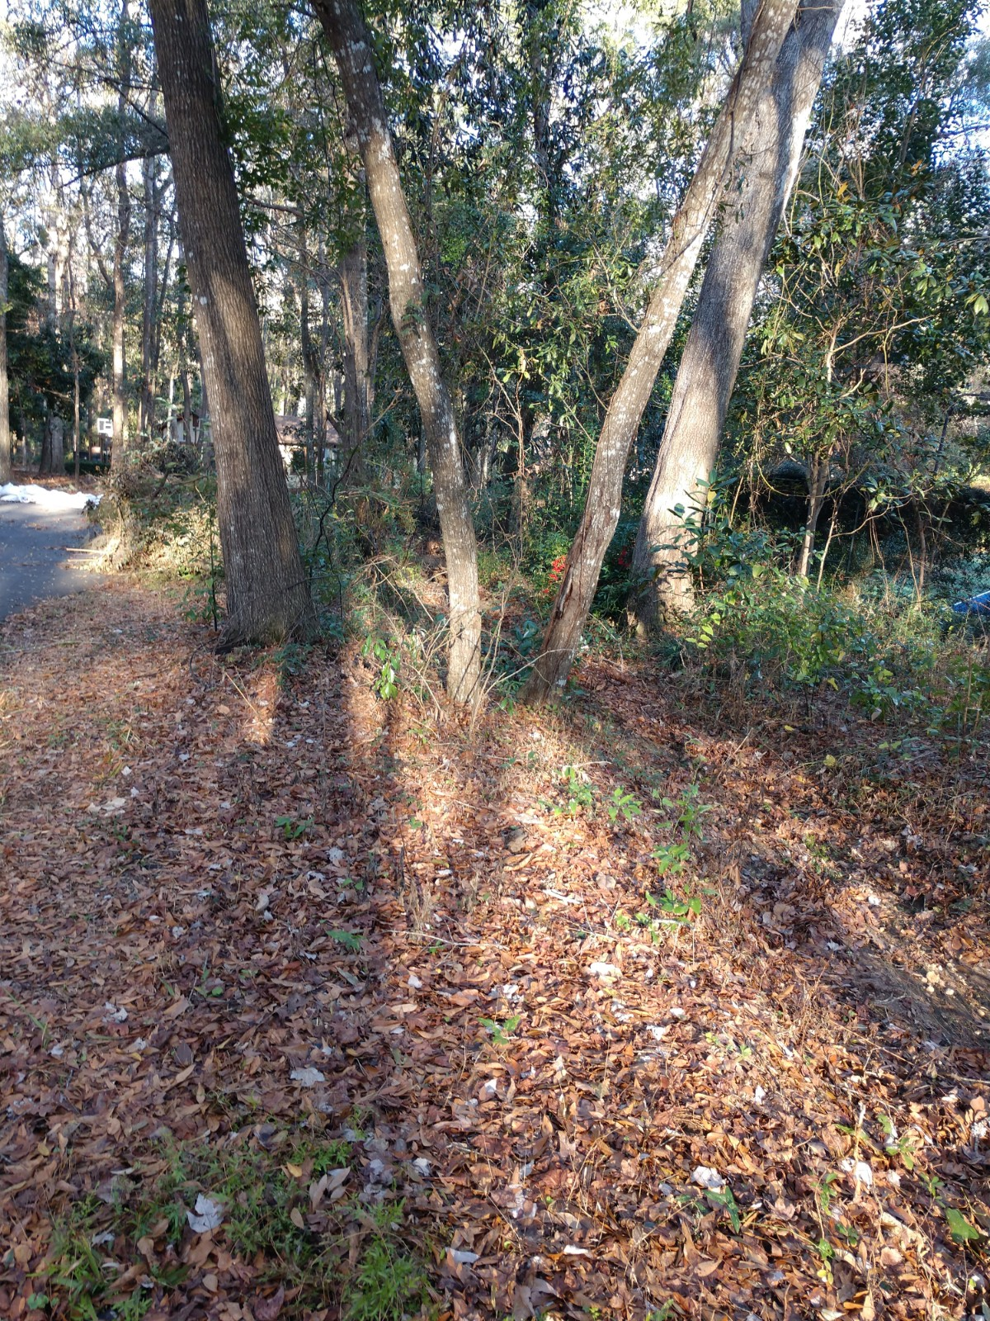

Slide 10
Total Costs of Project
$4620

